Slide 1
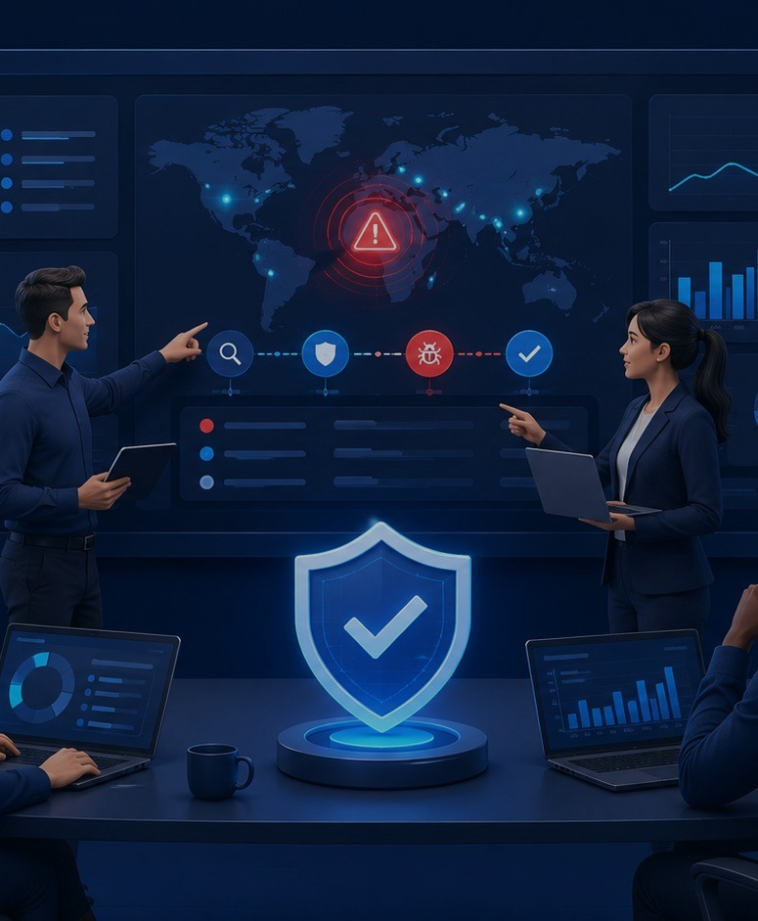
Cyber Threats
& Smart Defenses
A practical MIS lecture for BBA 3rd semester
Presented by
Syed Hassan Imam Naqvi
BSCYS-F21-A • LinkedIn: syed-hassan-imam
“Security is not only an IT topic. It is a business survival skill.”
MIS × Cybersecurity
01
Notes:
Open with a simple promise: students will understand cyber threats without needing deep technical knowledge.

Slide 2

Speaker snapshot
A quick intro, then we go straight into practical examples.
🏆
🚀
🎯
Black Hat MEA 2024
Competition Rank
Boozifyer
Community Work
CTF finalist at Riyadh, KSA in the Black Hat MEA 2024 cybersecurity competition.
Top 10 in Pakistan and Top 50 globally out of 250 Middle East & Asia teams.
Founder of Boozifyer, a startup providing cybersecurity services.
Organized 3 national CTF competitions and a cyber summit at Islamabad Chamber of Commerce with Chairman Chamber of Commerce, DG FIA, and AD NCCIA.
Goal for today: understand cyber risk like a future manager, not memorize hacker vocabulary.
MIS × Cybersecurity
02

Slide 3
Why cybersecurity matters in MIS
Management Information Systems depend on trusted data and working systems.
🏢
01
Businesses run on email, payroll, ERP, CRM and payment systems
📉
02
One cyber incident can stop operations and damage reputation
🧑‍💼
03
Managers approve policies, budgets and incident decisions
MIS takeaway: cybersecurity is a business issue, not just an IT issue.
No secure system = no reliable dashboard = “sir, the report is loading since yesterday.”
MIS × Cybersecurity
03

Slide 4
Common cyber threats
The basic attacks every business student should recognize.
🎣
Phishing
🦠
Malware
Fake messages or websites that steal logins or money
Software that spies, damages or disrupts systems
🔒
Ransomware
🧑‍🎭
Social Engineering
Locks files and demands payment
Manipulates people into risky actions
🔑
Password Attacks
🌊
DDoS
Guesses, reuses or steals passwords
Floods a service until it goes down
Today: phishing gets extra attention because it often opens the door for the rest.
MIS × Cybersecurity
04

Slide 5
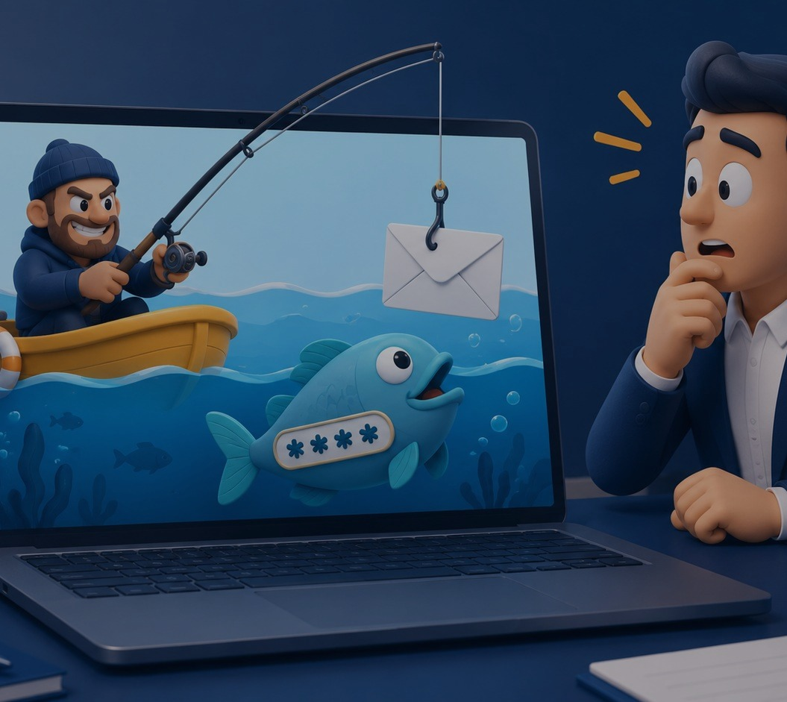
Phishing: how the trap works
Digital fishing: the message is the bait, the link is the hook.
Fake message
1
Urgent email, SMS or DM
Victim clicks
2
Because it looks trusted
Fake login
3
Looks like the real portal
Data stolen
4
Password, OTP, card info
Damage
5
Money, account or data loss
“Free Netflix semester plan” is probably not a scholarship. 😅
MIS × Cybersecurity
05

Slide 6
Spot the fake email
Look for pressure, mismatch, and anything that asks you to act too fast.
University Portal Alert
🚩 Sender domain is not official
From: it-support@university-secure-login.com
⏰ Urgency: “30 minutes”
Subject: URGENT: Verify account before exam portal closes
Dear Student,
Your exam portal access will expire in 30 minutes. Login immediately to avoid account suspension.
🔗 Link goes somewhere else
👤 Generic greeting
Login Now
📎 Unexpected downloads = danger
Hover link: https://uni-portal-login-check.example
Before clicking: check sender → hover link → use official app/site.
MIS × Cybersecurity
06

Slide 7
Fake portal: same face, different address
Phishing pages often copy the real login design. The address bar gives them away.
REAL portal
FAKE portal
🔒 https://portal.university.edu
⚠ https://portal-university-login.example
Student Portal
Student Portal
URGENT: verify within 10 minutes
Student ID
Email / Student ID
Password
Password + OTP
Login
Verify Now
Safe move: type the official website yourself. Never enter password or OTP on a link opened from a message.
MIS × Cybersecurity
07

Slide 8
Phishing is not only email
Same trick, different costume: trust + urgency + a risky action.
✉️
Email phishing
📱
SMS phishing
Fake university, bank or delivery emails
“Your parcel is held. Pay fee now.”
☎️
Phone phishing
🔗
Fake links
Caller pretends to be bank, HR or support
Shortened links or look‑alike domains
🪤
Fake portals
↪️
Redirect traps
Copied login pages for LMS, banking or Instagram
One safe-looking link silently jumps somewhere else
Audience question: Which one have you seen most often — SMS, call, email, or Instagram DM?
MIS × Cybersecurity
08

Slide 9
Check before you click
Useful public tools for suspicious links and exposed emails.
🛡️
VirusTotal
🔬
urlscan.io
virustotal.com
urlscan.io
Scan a URL/file with many security engines
See what a website loads without visiting it
🌐
Google Safe Browsing
📧
Have I Been Pwned
transparencyreport.google.com/safe-browsing
haveibeenpwned.com
Check whether Google currently flags a site
Check if your email appeared in known breaches
Important: do not submit private links with tokens/password reset codes to public scanners. Use official portals manually.
Sources: VirusTotal, urlscan.io, Google Safe Browsing, Have I Been Pwned official websites.
MIS × Cybersecurity
09

Slide 10
Strong passwords: boring but powerful
Weak passwords are still one of the easiest doors for attackers.
password
Common word
First few guesses / seconds
Hassan123
Name + numbers
Fast if attacker knows your name
Exam@2026
Topic + year
Better, but still guessable
river‑lamp‑coffee‑92!
Long passphrase
Much stronger if unique
Ideal password rule
Long + unique + not personal + stored in a password manager.
Exact cracking time depends on hardware, hash type and whether the password is already leaked.
Reference: Hive Systems Password Table 2025 explains how length and complexity affect brute-force estimates.
MIS × Cybersecurity
10

Slide 11
Ransomware: when files become hostages
It encrypts files, blocks access, and demands payment.
1
Often starts from phishing or weak passwords
⚠
2
Locks documents, databases and shared drives
YOUR FILES ARE LOCKED
Disconnect Wi‑Fi. Report to IT/security.
3
Business impact: downtime, panic and loss
48:00:00
4
Best defense: backups + recovery plan
Your thesis.pptx has left the chat. 💀
📄🔒
thesis.pptx
📄🔒
report.docx
📄🔒
finance.xlsx
MIS × Cybersecurity
11

Slide 12
Before ransomware happens
Precautionary measures that reduce the chance of infection.
💾
Back up important files
🔄
Update systems
Keep offline/cloud backups and test restoration
Install security patches for OS, browser and apps
🚫
Avoid cracked software
🔌
Be careful with USBs
Pirated tools and fake installers often carry malware
Do not plug unknown drives into lab/office PCs
📎
Block risky attachments
🧑‍🏫
Train people
Avoid EXE, ZIP, macros and “urgent forms”
People are the first firewall in most attacks
Rule: prevention is cheaper than recovery.
MIS × Cybersecurity
12

Slide 13
If ransomware happens: what to do
The first few minutes matter. Do not make the infection worse.
1
Disconnect
Turn off Wi‑Fi / unplug network. Stop spread.
2
Do not pay/click
Do not contact attacker or run random “fix” tools.
3
Report fast
Tell IT helpdesk, security team, faculty or admin.
4
Preserve evidence
Take photos/screenshots. Do not delete everything.
5
Recover safely
Restore from clean backups after investigation.
For students: report to university IT/helpdesk, lab assistant, instructor, or department admin.
MIS × Cybersecurity
13

Slide 14
Other everyday attacks
Important basic attacks beyond phishing and ransomware.
📲
Fake apps
📶
Public Wi‑Fi traps
Look-alike apps steal logins or show malware ads
Attackers can create “Free Campus Wi‑Fi” clones
Defense: Use official app stores and check publisher
Defense: Avoid sensitive logins; use mobile data/VPN
🎭
Social engineering
🌊
DDoS
Someone pressures you to share OTP or reset password
A website/app is flooded until unavailable
Defense: Verify through a second channel
Defense: Business needs monitoring and traffic protection
Core habit: when something feels rushed, unusual, or too good to be true — pause.
MIS × Cybersecurity
14

Slide 15
TFA / 2FA: Two-Factor Authentication
One password is one lock. 2FA adds a second lock.
Factor 1
Factor 2
Something you know
🔑
Something you have
📱
Password / PIN
Phone / Authenticator / Code
✓
Stolen password alone is not enough
✓
Works best with an authenticator app or strong PIN
✓
Alerts you about suspicious login attempts
✓
Still requires common sense: do not share codes
MIS × Cybersecurity
15

Slide 16
Enable 2FA on WhatsApp & Instagram
A practical mitigation strategy students can apply today.
WhatsApp
Instagram
Pros of 2FA
✓
Protects account if password leaks
Settings
Profile menu
✓
Blocks many account takeovers
Account
Accounts Center
✓
Warns you about strange logins
Two-step verification
Password and security
Turn on / Set up PIN
Two-factor authentication
✓
Use backup codes and never share OTP
Create 6-digit PIN
Choose account
Add recovery email
Authenticator app / SMS
2FA = account bouncer.
No code, no entry.
Sources: WhatsApp Help Center and Instagram Help Center 2FA instructions.
MIS × Cybersecurity
16

Slide 17
Real-life student scenario
A normal day… until a fake message appears before exams.
1
2
3
😰
🤔
✅
The trap
The smart move
The action
“Your exam portal password expired. Login now.”
Pause. Check sender. Open portal manually.
Report to IT/faculty and warn classmates.
Class rule: deadline panic is the attacker’s favorite weapon.
MIS × Cybersecurity
17

Slide 18
Quick class check
Ask the room before revealing the safest option.
Scenario: You receive this WhatsApp message:
What should you do first?
A
Click quickly before deadline
“Urgent! Your scholarship form is rejected.
Login here now: bit.ly/uni-help-portal”
B
Forward to whole class
C
Open official portal manually
D
Reply with your password
Correct: C. Open the official website/app manually and verify from a trusted source.
MIS × Cybersecurity
18

Slide 19
Key takeaways
Five simple rules students can actually use today.
1
Pause before clicking
2
Verify sender, link and portal
3
Use unique passwords
4
Turn on 2FA / TFA
5
Report suspicious messages
Cyber awareness is a business skill, not just a technical skill.
Questions?
MIS × Cybersecurity
19

Slide 20
Thank You
?
Questions?
Ask anything — no question is too basic.
Cybersecurity awareness is not just an IT skill — it is a business survival skill.
Pause • Verify • Stay Secure
Presented by Syed Hassan Imam Naqvi | LinkedIn: syed-hassan-imam

